Slide 1
Lectures 22 and 23: Autoencoders and Generative Adversarial Networks --- Examples
Mark Hasegawa-Johnson
ECE 417, Fall 2020

Slide 2
GAN and BAE examples
Image generation using a generative adversarial network
Audio generation by tuning a bottleneck autoencoder
MoCoGAN: MP6

Slide 3
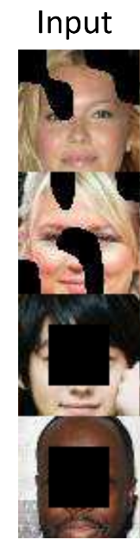
Semantic Image Inpainting with Deep Generative Models Raymond Yeh, Chen Chen, Teck Yian Lim, Alexander G. Schwing, Mark Hasegawa-Johnson and Minh Do
The problem:

Slide 4
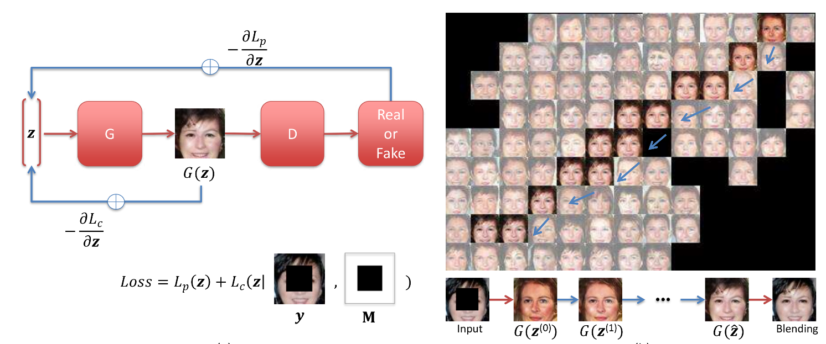
Semantic Image Inpainting
The solution:

Slide 5
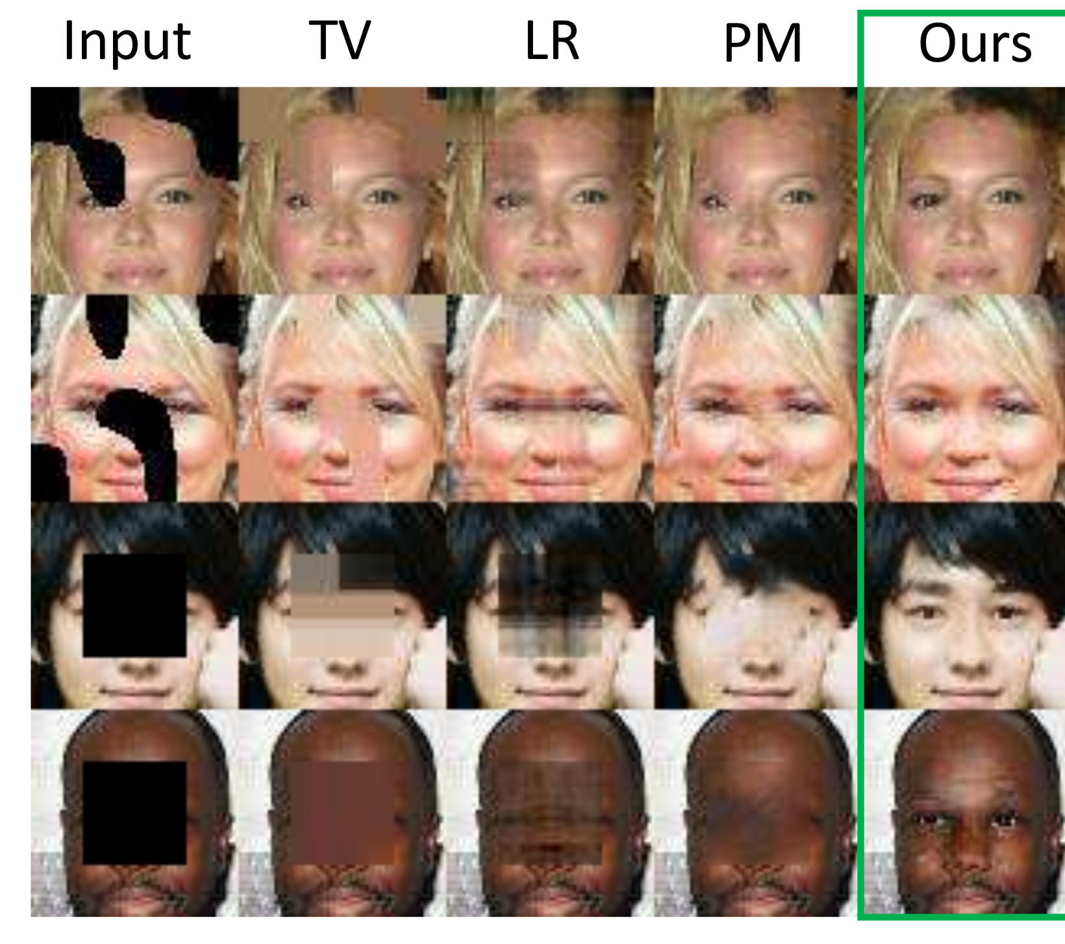
Semantic Image Inpainting
The results:

Slide 6
GAN and BAE examples
Image generation using a generative adversarial network
Audio generation by tuning a bottleneck autoencoder

Slide 7
AutoVC: Zero-Shot Voice Style Transfer with Only Autoencoder Loss
Qian, Zhang, Chang, Yang, Hasegawa-Johnson, ICML 97:5210-5219, 2019
Voice conversion aims to modify the source speech to make it sound like it’s being spoken by a different person.
Existing voice style transfer techniques:
Generative Adversarial Network: match the target speaker distribution, but hard to train
Variational Auto-Encoder: doesn’t match the target speaker distribution
Only convert between seen speakers
AutoVC:
With careful bottleneck tuning, autoencoder sufficient to achieve natural-sounding speech
Can convert between unseen speakers

Slide 8
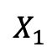
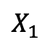
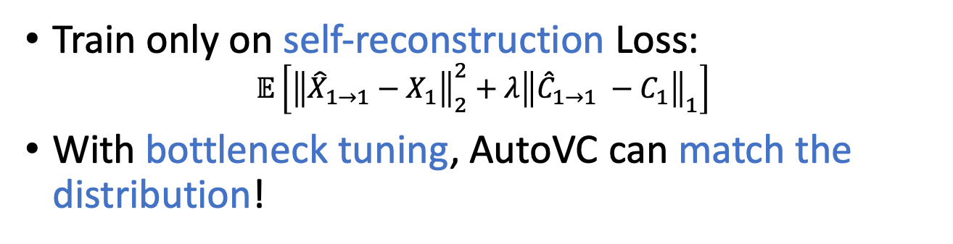
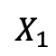
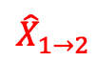
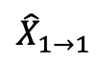
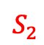
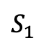
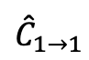
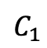
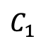
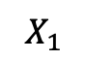
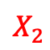
AutoVC
Qian, Zhang, Chang, Yang, Hasegawa-Johnson, “AutoVC: Zero-Shot Voice Style Transfer with Only Autoencoder Loss,” Proc MMLR 97:5210-5219, 2019
$$X_{1}$$
Content Encoder
$$C_{1}$$
Decoder
$${\hat{X}}_{1→1}$$
$$X_{1}$$
Content Encoder
$$C_{1}$$
Decoder
$${\hat{X}}_{1→2}$$
$${\hat{C}}_{1→1}$$
$$X_{1}$$
$$X_{1}$$
Speaker Encoder
$$S_{1}$$
$$X_{2}$$
Speaker Encoder
$$S_{2}$$
Training
Conversion
Train only on self-reconstruction Loss:
$$𝔼\left[{\left\|{\hat{X}}_{1→1}−X_{1}\right\|}_{2}^{2}+λ{\left\|{\hat{C}}_{1→1} −C_{1}\right\|}_{1}\right]$$
With bottleneck tuning, AutoVC can match the distribution!

Slide 9
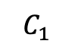
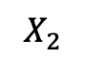
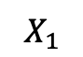
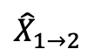
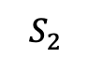
AutoVC
$$X_{1}$$
Content Encoder
$$C_{1}$$
Decoder
$${\hat{X}}_{1→2}$$
Seen OR Unseen
Speaker Encoder
$$X_{2}$$
$$S_{2}$$
Conversion
Speaker encoder is pretrained
Can generalize to unseen speakers – zero-shot conversion

Slide 10
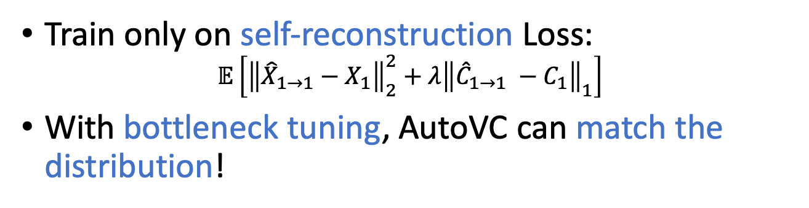
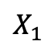

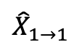
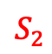
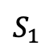
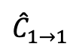
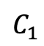
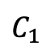
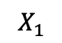
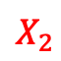
AutoVC
$$X_{1}$$
Content Encoder
$$C_{1}$$
Decoder
$${\hat{X}}_{1→1}$$
$$X_{1}$$
Content Encoder
$$C_{1}$$
Decoder
$${\hat{X}}_{1→2}$$
$${\hat{C}}_{1→1}$$
$$X_{1}$$
$$X_{1}$$
Speaker Encoder
$$S_{1}$$
$$X_{2}$$
Speaker Encoder
$$S_{2}$$
Training
Conversion
Train only on self-reconstruction Loss:
$$𝔼\left[{\left\|{\hat{X}}_{1→1}−X_{1}\right\|}_{2}^{2}+λ{\left\|{\hat{C}}_{1→1} −C_{1}\right\|}_{1}\right]$$
With bottleneck tuning, AutoVC can match the distribution!

Slide 11
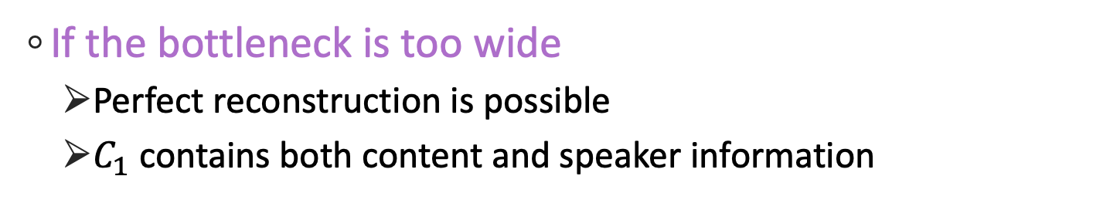
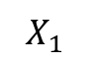
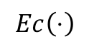
Why does it work?
$$Ec\left(⋅\right)$$
$$D\left(⋅,⋅\right)$$
$$C_{1}$$
$$X_{1}$$
$$S_{1}$$
$${\hat{X}}_{1→1}$$
If the bottleneck is too wide
Perfect reconstruction is possible
$C_{1}$ contains both content and speaker information

Slide 12
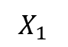
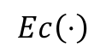
Why does it work?
$$Ec\left(⋅\right)$$
$$D\left(⋅,⋅\right)$$
$$C_{1}$$
$$X_{1}$$
$$S_{1}$$
$${\hat{X}}_{1→1}$$
If the bottleneck is too narrow
Perfect reconstruction is impossible,
because content information is lost

Slide 13
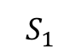
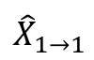
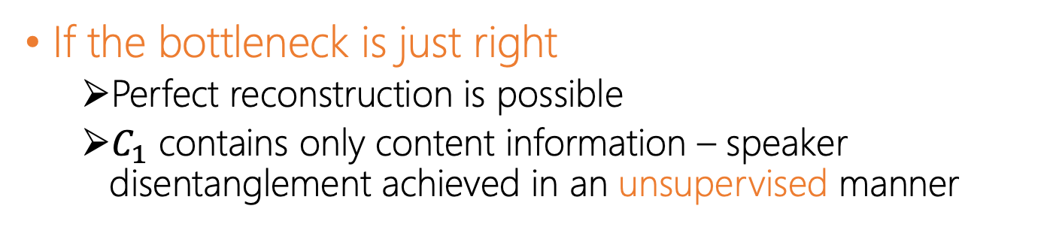
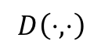
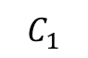
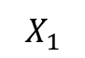
Why does it work?
$$Ec\left(⋅\right)$$
$$D\left(⋅,⋅\right)$$
$$C_{1}$$
$$X_{1}$$
$$S_{1}$$
$${\hat{X}}_{1→1}$$
If the bottleneck is just right
Perfect reconstruction is possible
$C_{1}$ contains only content information – speaker disentanglement achieved in an unsupervised manner

Slide 14
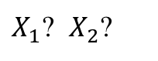
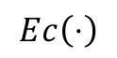
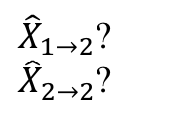
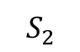
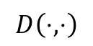
Why does it work?
Reconstruction Error vs Speaker Classification Accuracy
$$Ec\left(⋅\right)$$
$$D\left(⋅,⋅\right)$$
$$C_{1}$$
$X_{1}$? $X_{2}$?
${\hat{X}}_{1→2}$? ${\hat{X}}_{2→2}$?
$$S_{2}$$
If the bottleneck is just right
During the actual conversion, the output should contain no source speaker information.
If self-reconstruction sounds good, then conversion sounds good.

Slide 15
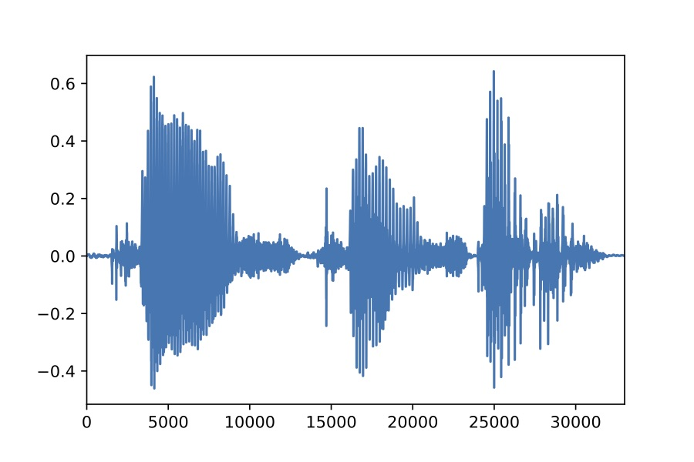

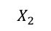
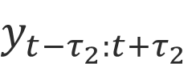













The AutoVC Architecture
Spectrogram Inverter
Content Encoder
Decoder
$$X_{1}$$
(a)
512 32$×$2 320 512 1024 80 512 80
$${\hat{X}}_{1→2}$$
(d)
Down1
$$C_{1→}$$
Up1
BLSTM $×2$
WaveNet
5$×$1 ConvNorm $×3$
1$×$1 Conv
Deconv $×4$
5$×$1 ConvNorm $×4$
LSTM $×3$
5$×$1 ConvNorm
5$×$1 ConvNorm $×3$
+
$$E_{s}\left(⋅\right)$$
Down2
$$C_{1←}$$
Up2
$$X_{2}$$
Concatenate
LSTM $×$2
Full Connect
Copy
Down1
Up1
Down2
Up2
Last Output
$$S_{2}$$
(b)
(c)
(e)
(f)
768 256 80
Speaker Encoder

Slide 16

Conventional Many-to-many Conversion
To hear is to believe
Here are the reference speakers, in their own voices:
Adversarial game: Utterance will be “Please call Stella.” All three (T1, T2, and T3) are resynthesized from the content code of one (T1, T2, or T3). Which one?
Who is Sa? T1, T2 or T3?
Who is Sb? T1, T2 or T3?
 | T1 | T2 | T3
Sa
Sb

Slide 17
Conventional Many-to-many Conversion
Mean Opinion Score (MOS): 1-5 on the quality of speech
Similarity Score: 1-5 on the similarity of a conversion-target pair
MOS
Similarity
AutoVC
AutoVC-one-hot
StarGAN¹
Chou et. al.²
¹StarGAN-VC: Non-parallel many-to-many voice conversion with star generative adversarial networks
²Multi-target Voice Conversion without Parallel Data by Adversarially Learning Disentangled Audio Representations

Slide 18

Zero-shot Conversion
The first zero-shot voice conversion framework (”unseen” = AutoVC has never seen audio of this speaker, only his/her speaker ID vector)
Subjective Evaluation
 | Seen M | Seen F | Unseen M | Unseen F
Unseen M
Unseen F
MOS
Similarity
Seen to seen
Seen to unseen
Unseen to seen
Unseen to unseen

Slide 19
GAN and BAE examples
Image generation using a generative adversarial network
Audio generation by tuning a bottleneck autoencoder
MoCoGAN: MP6

